Slide 1
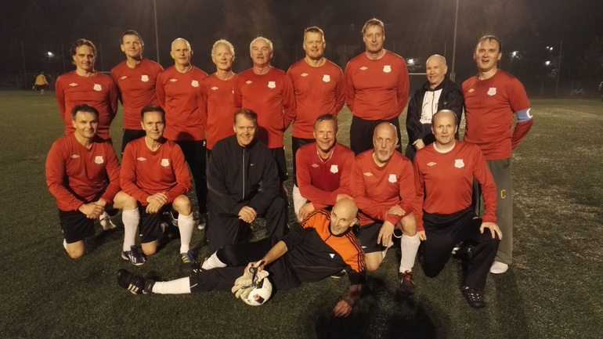
Asko, Kai, Pete, Immo, Tiude; Timo, Hannu, Reijo Ippe
Harri, Ossi, Raine, Andy, Tate, Kari
Selle

